Slide 1
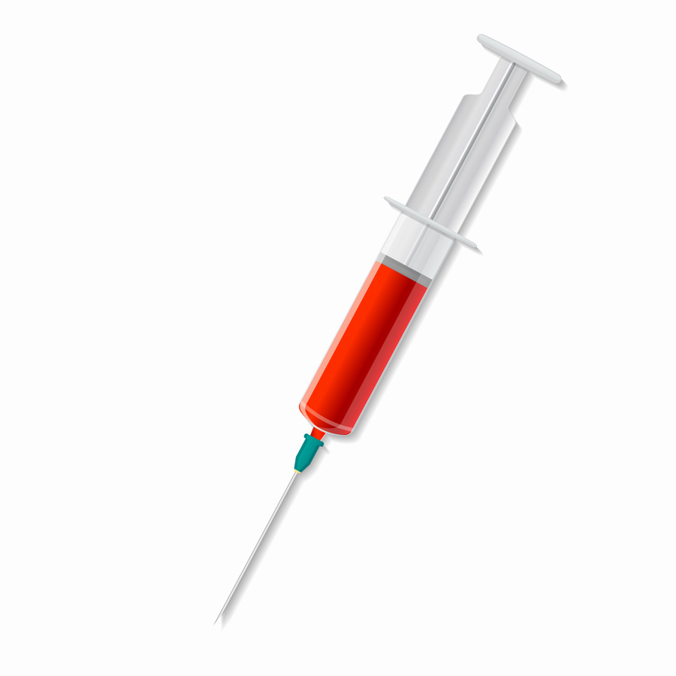
Phlebotomy Program
Spring 2025 – Del Norte
Adult and Community Education
Program Director: Jim Gordon
Instructor: Roxanne Garman

Slide 2
Welcome and Introductions

Slide 3
Agenda
What phlebotomy is and what it is not
What are the state requirements?
Course information, dates and format
Application process
Cost and funding options

Slide 4
What’s a Phlebotomist?
Practices in hospitals, clinics and freestanding labs
Direct patient contact/care
Responsible for blood draws (venipuncture) and collections
Does not administer medications or initiate IV access

Slide 5
What makes a good Phlebotomist?
Patience!
Empathy
Critical thinking skills
Communication skills
People skills

Slide 6
About the program.
Not-for-Credit Program
Nationally recognized certification exam is included (NHA)
Class includes:
Phlebotomy class
Basic CPR: BLS for healthcare
Textbooks, handouts, and NHA online resources and practice tests
Materials and supplies for laboratory portions of the class
Clinical rotation in a healthcare facility
Job Prep (resume, cover letter, interviewing)

Slide 7
Program Dates
Dates: January 11th – April 26th, 2025
16 in person didactic/lab sessions – includes 2 makeup days
Days: Saturdays
Time: 9:00AM – 4:30PM (1/2 hr. lunch)
Location: 883 W. Washington Blvd., Crescent City, CA
ALL class meetings are face-to-face
NHA Exam: Saturday, May 10th, 2025. Time: 9:00AM-11:00AM
***Dates are subject to change***

Slide 8
Clinical Externship
Performed at a local healthcare facility
Program Director will place ALL students
Every attempt will be made to place you in your preferred clinical location.
Compliance documents are required by the sites
When compliance paperwork has cleared: you will be contacted to pickup your blue clinical folder.
This will be used to record the following:
40 hours
50 successful venipunctures.
10 dermal sticks & 2 arterial blood gas observations – (TBD in class).
Students are responsible for the safekeeping of their folder, including returning it our office upon completion of externship

Slide 9
Health and Safety
Class size: 18 students
PPE and hand/hygiene availableIf you’re sick, stay home
Call and email your instructor, as well as the ACE office.
1 absence allowed!
Program regulations and policies are strictly enforced.

Slide 10
Immunizations/Screenings Costs and Guidelines
These must be submitted ASAP – after being accepted or waitlisted
PLEASE – refer to Immunization/Screening Checklist for specific details
Immunization | Approximate Cost*
MMR Measles, mumps, rubella | $17.00
Varicella/Chicken Pox | $129
Hepatitis B Series | $55/Per Dose
TDAP Tetanus, diptheria, abd pertussis | Unknown
TB Tuberulosis | Unknown

Slide 11
Immunization/Screening Information
You must provide paper copies of all required immunizations
Healthcare providers, school, parents, family
You can get a Quantitative Titer for most immunizations:
This will show if you have the antibodies.
If no antibodies are present; you must get the immunization(s)!.

Slide 12
Program Costs
Program Fee: $1,995.00
Other costs:
Background Check - $35-$37
Physical Exam– costs will vary
Immunizations – costs will vary
CPT 1 License Fees - Approximately $100

Slide 13
Payment options
There are three (3) ways to pay for the class:
Payment in full: cash, check or credit/debit card
Nelnet Payment Plan (next slide)
Sponsored by an agency/community partner
There are several potential opportunities: local, county, state or federal
Potential sponsorship opportunities form on website
*Until our office has written documentation
confirming sponsorship, your registration will
not be processed!

Slide 14
Nelnet Payment Plan
Class | Phlebotomy Payment Plan
Total Cost | $1,995
Down Payment | Option 1: $1,000 + a $20 non-refundable payment plan fee Option 2: $500 +a $20 non-refundable payment plan fee
Monthly Payment Amount | Option 1: Approximately $332 for 3 months Option 2: Approximately $500 for 3 months
Payment plans are processed with a Debit/Credit card only!
Payment plan must be established in order to register.

Slide 15
Application Packet: Process / Requirements
Application packet MUST include:
forms and/or instructions are all on the program website
Completed application
Completed background check
High School (or equivalent) transcripts (current, unofficial is acceptable)
Incomplete application packets will not be accepted
E-mail: ace@redwoods.edu
Subject Line: your last name, your first name: Phlebotomy Application Packet
Items can be separate attachments but must be in 1 email.

Slide 16
Program Process (after application period closes)
Application period closes November 22nd, 2024
Random lottery drawing and letters mailed, and emails sent out : no later than November 25th, 2024
Names will be drawn and assigned a #
First 18 names drawn will receive acceptance letters/emails
Remaining names drawn will receive waitlist letters/emails, and their assigned # (#3 of 25, #16 of 25, etc.)
Acceptance letters will include:
Registration Form
NelNet Information
Immunization/Screening Checklist
Physical Exam Form
Potential Sponsorship Opportunities information
Waitlist letters will include:
Immunization/Screening Checklist
Physical exam form
NelNet Information
Potential sponsorship opportunities information

Slide 17
Requirements to apply for CPT 1 License
HS diploma or equivalent - official, sealed transcripts are submitted directly to CDPH
Background check
Completion of an approved certification program (like this one)
Pass the National Healthcareer Association (NHA) Phlebotomy certification exam
Completion of a 40-hour Clinical Externship (unpaid)
Application to the California Department of Public Health (CDPH) with required fees

Slide 18
Questions????
Email: ACE@redwoods.edu
Phone: 707-476-4500
Address: 525 D Street Eureka, CA 95501
Office Hours: Monday – Friday 8:30a-4:30p

